Slide 1
stock forecasting for the Telecom Industry
Plug n Play Capabilities

Slide 2
Once upon a time-

Slide 3
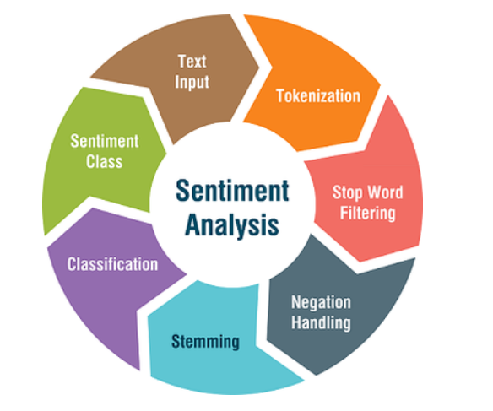
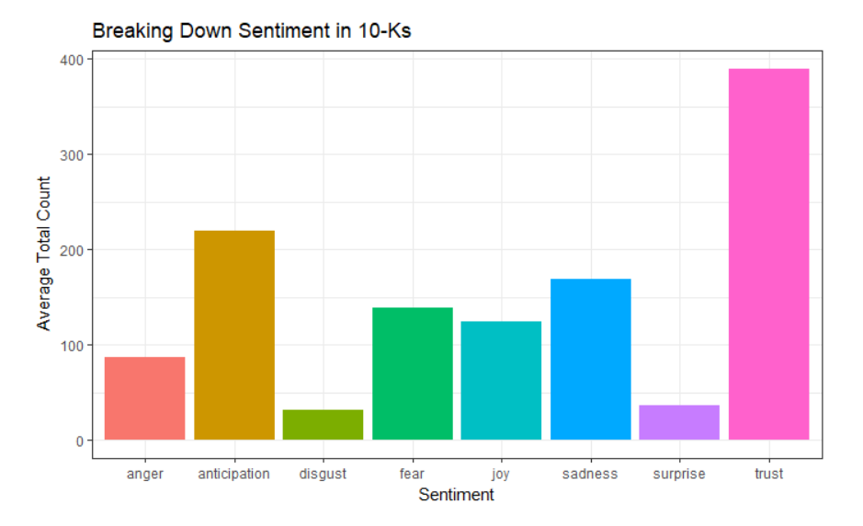
A Sentiment Analysis Approach to Predicting Stock Returns Twitter/News

Slide 4
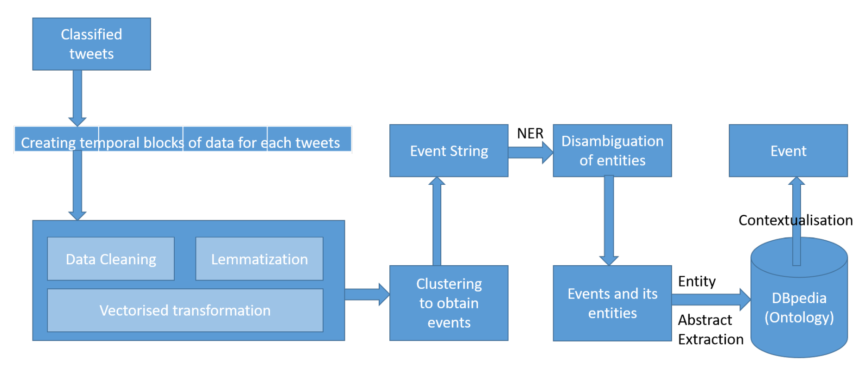
Processing of Tweets and Sentiment Identification

Slide 5
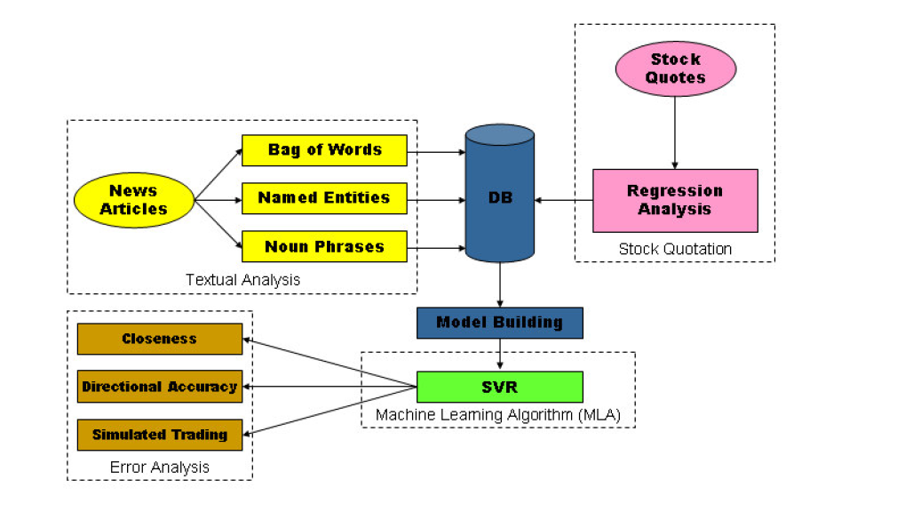
AZFinText system News Classification

Slide 6
Over view of Features
Stock Price(2)
TimSeries Adj Close
Prediction of AdjClose by ML model~ Open, High, Low, Close, Volume *500 companies
Tweet Data(8)
Anger
Anticipation
NEWS Data(8)
Anger
Disgust
Surprise
Sadness
Fear
Joy
Trust
Anticipation
Disgust
Fear
Joy
Surprise
Sadness
Trust

Slide 7
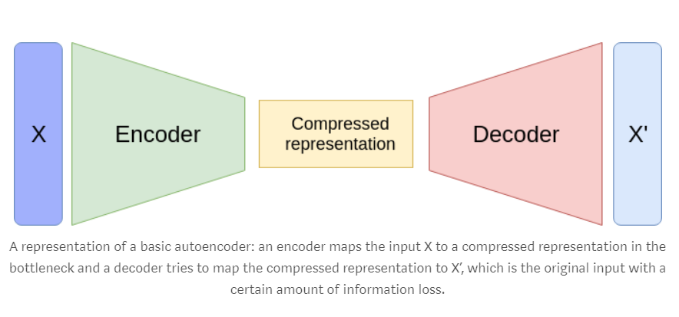
Autoencoders for the compression of stock market time series

Slide 8
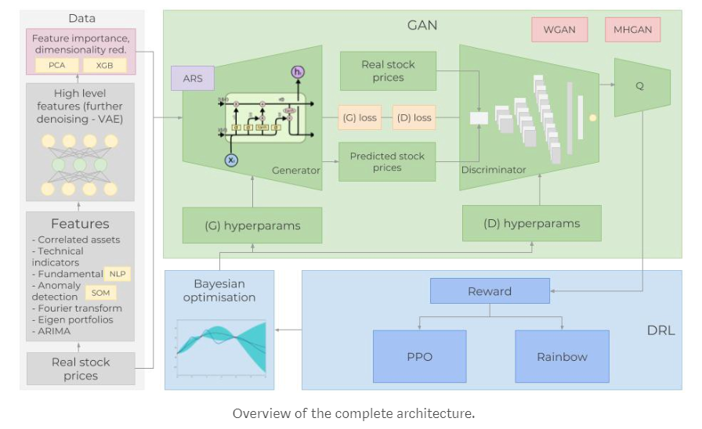
Time series Model – bert +gan

Slide 9
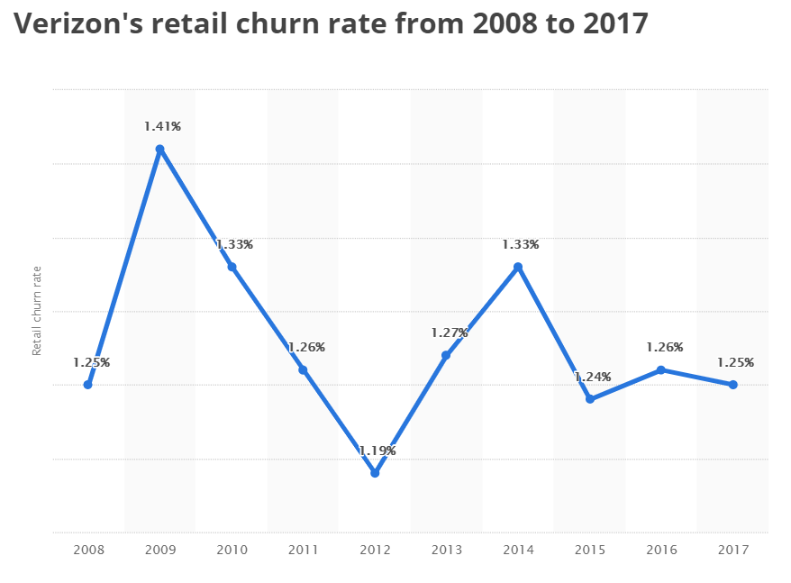
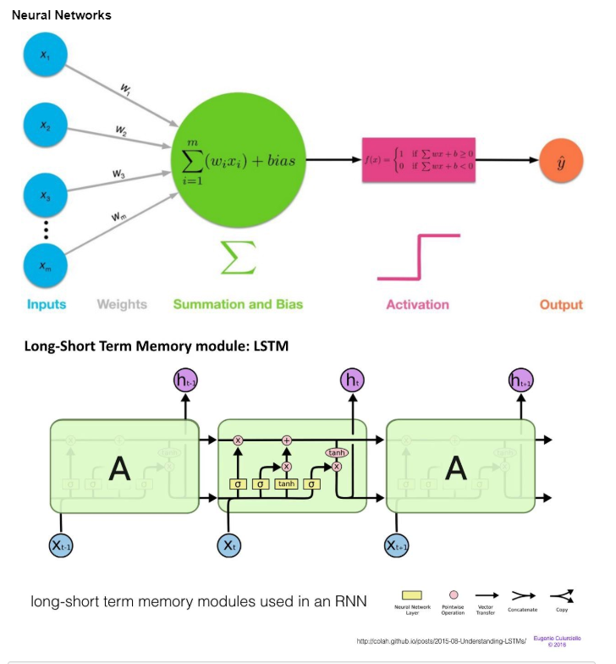
Churn Rate Processing -LSTM

Slide 10
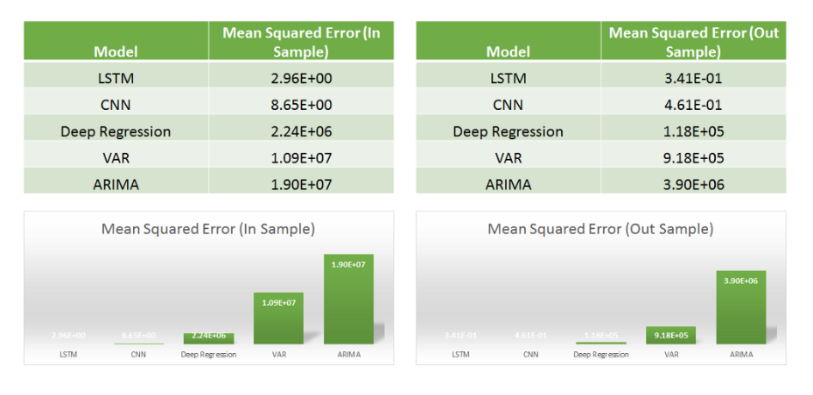
Baseline Churn Rate Time series models

Slide 11
Over view of Features for RF/Mlp NN
Pre- Model (1)
Prediction of AdjClose
Churn Data(8)
LSTM
CNN
Deep Regression
VAR
ARIMA

Slide 12
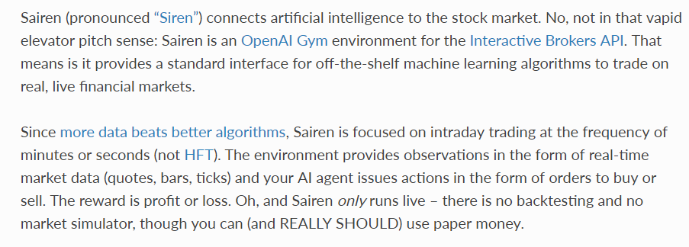
Sairen - OpenAI Gym Reinforcement Learning Environment for the Stock Market

Slide 13
Architecture For SOTA
Twitter
Model
input
RF/MLP
Model
output
News
Model
input
NYSE
Model
Churn Rate
Model
input
input

Slide 14
Current Updates – Twitter/NEws Model
Total number of features – 18
retweets
favorites
lm_positive
lm_negative
lm_polarity
lm_subjectivity
actvie
passive
weak
strong
anger
joy
suprise
sadness
disgust
anticipation
fear
trust

Slide 15
NEWS Model - Results
Number of data points considered for:
Number of Data points : 1716
Training: 1544
Testing: 172 (0.1%)
Company | StartDate | EndDate | NEWS dtpt
VZ | 03/08/2004 | 29/01/2019 | 1076
S | 21/05/2013 | 22/02/2019 | 640
Model | Lag1 | Lag2 | Lag3 | Lag4 | Lag5 | Lag6 | Lag7
Rf | 50.00% | 47.09% | 46.51% | 48.25% | 48.25% | 54.06% | 52.90%
BERT + Rf | 48.83% | 45.93% | 40.69% | 45.93% | 50.58% | 44.76% | 48.83%
18 features +Random forest configuration:
Estimators: 5000
Depth of tree: 4
BERT + Random forest configuration:
Estimators: 5000
Depth of tree: 4

Slide 16
Twitter Model - Results
Number of data points considered for:
Number of Data points – 5004
Training: 4503
Testing: 501 (0.1%)
Company | StartDate | EndDate | Tweets
VZ | 07/12/2007 | 25/01/2019 | 3329
S | 09/12/2013 | 21/02/2019 | 1675
Model | Lag1 | Lag2 | Lag3 | Lag4 | Lag5 | Lag6 | Lag7
Rf | 54.49% | 53.49% | 50.49% | 47.50% | 48.90% | 50.49% | 51.69%
BERT + Rf | 55.68% | 50.29% | 51.09% | 49.70% | 49.90% | 50.69% | 52.89%
18 features +Random forest configuration:
Estimators: 5000
Depth of tree: 4
BERT + Random forest configuration:
Estimators: 5000
Depth of tree: 4

Slide 17
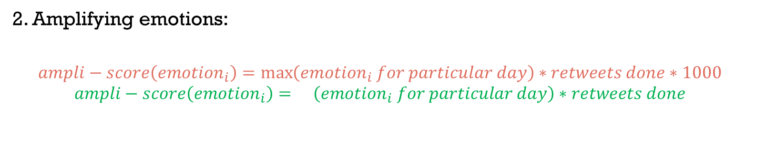
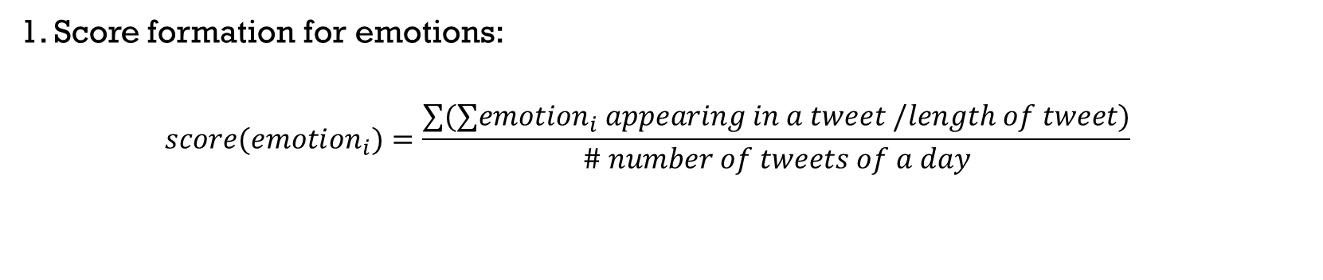
Twitter Model With Amplification- Results
1. Score formation for emotions:
$$score(emoti{on}_{i})=\frac{∑(∑emotion_{i} appearing in a tweet /length of tweet)}{\# number of tweets of a day}$$
Where i = {anger, sadness, anticipation, fear, joy, happy, disgust, trust}
2. Amplifying emotions:
$$ampli−score\left(emoti{on}_{i}\right)=\max\left(emotion_{i} for particular day\right)∗retweets done∗1000$$
$$ampli−score\left(emoti{on}_{i}\right)=\left(emotion_{i} for particular day\right)∗retweets done$$
Where i = {anger, sadness, anticipation, fear, joy, happy, disgust, trust}
3. Rows with no variance were removed.
4. Correlation between features handled by removing co-related columns by VIF.

Slide 18
Twitter Model With Amplification- Results
Number of data points considered for:
Number of Data points – 3828
Training: 3445
Testing: 383 (0.1%)
Company | StartDate | EndDate | Tweets
VZ | 07/12/2007 | 25/01/2019 | 2573
S | 09/12/2013 | 21/02/2019 | 1255
Model | Lag1 | Lag2 | Lag3 | Lag4 | Lag5 | Lag6 | Lag7
A. Rf (VIF) | 52.21% | 46.73% | 46.47% | 47.78% | 51.10% | 52.21% | 51.43%
B. Rf (VIF) | 53.00% | 46.21% | 45.69% | 45.95% | 48.82% | 49.60% | 47.51%
10 features (VIF) +Random forest configuration:
Estimators: 5000
Depth of tree: 4
9 features (VIF) + Random forest configuration:
Estimators: 5000
Depth of tree: 4

Slide 19
Architecture For SOTA
Twitter
Model
input
RF/MLP
Model
output
News
Model
input
NYSE
Model
Churn Rate
Model
input
input

Slide 20

NEWS Model – Results (MSFT)
Company | StartDate | EndDate | NEWS dtpt
VZ | 03/08/2004 | 29/01/2019 | 1076
S | 21/05/2013 | 22/02/2019 | 640
Microsoft | 21/07/2004 | 28/03/2019 | 4020
Number of data points considered for:
Number of Data points : 4020
Training: 3618
Testing: 402 (0.1%)
Model | Lag1 | Lag2 | Lag3 | Lag4 | Lag5 | Lag6 | Lag7
Rf | 50.00% | 47.09% | 46.51% | 48.25% | 48.25% | 54.06% | 52.90%
BERT + Rf | 48.83% | 45.93% | 40.69% | 45.93% | 50.58% | 44.76% | 48.83%
RF | 63.93% | 58.70% | 48.75% | 51.74% | - | - | -
BERT + Rf | 63.43% | 55.47% | 46.26% | 56.96% | - | - | -
18 features +Random forest configuration:
Estimators: 5000
Depth of tree: 4
BERT + Random forest configuration:
Estimators: 5000
Depth of tree: 4

Slide 21
NEWS Model – Results (MSFT)
Watching Eureka movement to disappear with Precision matrix for individual class.
Model | Lag1 | Lag2 | Lag3 | Lag4
RF – 0 | 0.78 | 0.71 | 0.29 | 0.05
RF – 1 | 0 | 0 | 0.57 | 0.72
BERT + Rf – 0 | 0.79 | 0.75 | 0.31 | 0.01
BERT + Rf – 1 | 0 | 0 | 0.48 | 0.74

Slide 22
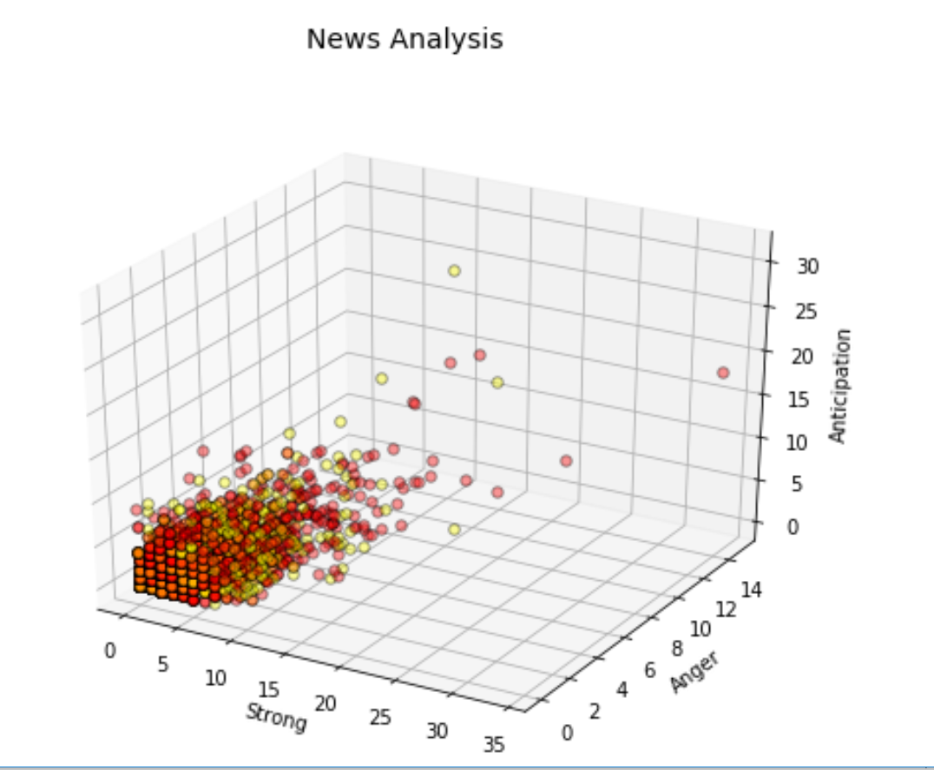
NEWS Model – Viz attributes (MSFT)
Visualisation of attributes – strong, anger and anticipation against whether the stock went up for the subsequent day or not.
DOWN
UP

Slide 23


NEWS Model – word cloud (MSFT)
Visualisation of words in news against the following day up and down closing of the stocks, to gather information if rule-based system can be delivered to tackle volatility in stock price.

Slide 24
At A Glance: Microsoft Dataset
Training data point : < 2018/06/01
Testing data point : >= 2018/06/01
Company | Start Date | End Date | Data points (days) | Train | Test | f | `f (VIF)
Microsoft News | 2004/07/21 | 2019/03/28 | 4020 | 3806 | 214 | 25 | 22
Microsoft Twitter | 2015/05/04 | 2019/04/04 | 1426 | 1118 | 308 | 24 | 11
Microsoft Finance | 2003/04/30 | 2019/04/03 | 4010 | 3798 | 209 | 30 | 9
Combine | 2003/04/30 | 2019/04/04 | 5004 | 4696 | 308 | 79 | -

Slide 25
NEWS Model ml- Results
Training data point : < 2018/06/01
Testing data point : >= 2018/06/01
S- Scaled Dataset
NS- Non-Scaled Dataset
Company | Start Date | End Date | Data points (days) | Train | Test | f | `f (VIF S/NS)
MSFT News | 2004/07/21 | 2019/03/28 | 4020 | 3806 | 214 | 25 | 18/22
Model | Accuracy(NS) | Accuracy(S) | Precision(NS) | Precision(S) | Recall(NS) | Recall(S) | F1-score(NS) | F1-score(S)
RandomForest | 53.27 | 50.93 | 0.88 | 0.74 | 0.53 | 0.51 | 0.64 | 0.58
Adaboost | 50.46 | 47.66 | 0.51 | 0.48 | 0.50 | 0.48 | 0.51 | 0.48
GradientTreeBoosting | 50.00 | 50.00 | 0.50 | 0.50 | 0.50 | 0.50 | 0.50 | 0.50
VotingClassifier | 51.00 | 53.00 | - | - | - | - | - | -
xGBoosting | 52.30 | 53.60 | 0.40 | 0.45 | 0.52 | 0.54 | 0.37 | 0.40
Voting Classifier –
1.Logisitc Regression 2.Random Forest 3.naive Bayes 4.AdaBoost Classifier 5.Gradient Boosting Tree

Slide 26
NEWS Model ml BERT - Results
Training data point : < 2018/06/01
Testing data point : >= 2018/06/01
S- Scaled Dataset
NS- Non-Scaled Dataset
Company | Start Date | End Date | Data points (days) | Train | Test
MSFT News | 2004/07/21 | 2019/03/28 | 4020 | 3806 | 214
Model | Accuracy(NS) | Accuracy(S) | Precision(NS) | Precision(S) | Recall(NS) | Recall(S) | F1-score(NS) | F1-score(S)
RandomForest
Adaboost
GradientTreeBoosting
VotingClassifier
xGBoosting
Voting Classifier –
1.Logisitc Regression 2.Random Forest 3.naive Bayes 4.AdaBoost Classifier 5.Gradient Boosting Tree

Slide 27
NEWS Model dl BERT - Results
Training data point : < 2018/06/01
Testing data point : >= 2018/06/01
S- Scaled Dataset
NS- Non-Scaled Dataset
Company | Start Date | End Date | Data points (days) | Train | Test
MSFT News | 2004/07/21 | 2019/03/28 | 4020 | 3806 | 214
Model (ep =200) | Accuracy(NS) | Accuracy(S) | Precision(NS) | Precision(S) | Recall(NS) | Recall(S) | F1-score(NS) | F1-score(S)
Naïve Bayes
DenseNetwork
CNN_LSTMNetwork
CNN_BideirectionalLSTMNetwork
CNN_GRUNetwork
CNN_RNNNetwork

Slide 28
Twitter Model ml- Results
Training data point : < 2018/06/01
Testing data point : >= 2018/06/01
S- Scaled Dataset
NS- Non-Scaled Dataset
Company | Start Date | End Date | Data points (days) | Train | Test | f | `f (VIF S/NS)
MSFT Tweets | 2015/05/04 | 2019/04/04 | 1426 | 1118 | 308 | 24 | 12/11
Model | Accuracy(NS) | Accuracy(S) | Precision(NS) | Precision(S) | Recall(NS) | Recall(S) | F1-score(NS) | F1-score(S)
RandomForest | 53.57 | 55.19 | 0.91 | 0.73 | 0.54 | 0.55 | 0.66 | 0.60
Adaboost | 48.70 | 48.05 | 0.55 | 0.50 | 0.49 | 0.48 | 0.51 | 0.49
GradientTreeBoosting | 53.57 | 53.24 | 0.60 | 0.54 | 0.54 | 0.53 | 0.56 | 0.53
VotingClassifier | 52.00 | 53.00 | - | - | - | - | - | -
xGBoosting | 53.90 | 52.60 | 0.49 | 0.48 | 0.54 | 0.53 | 0.42 | 0.44
Voting Classifier –
1.Logisitc Regression 2.Random Forest 3.naive Bayes 4.AdaBoost Classifier 5.Gradient Boosting Tree

Slide 29
Twitter Model ml BERT - Results
Training data point : < 2018/06/01
Testing data point : >= 2018/06/01
S- Scaled Dataset
NS- Non-Scaled Dataset
Company | Start Date | End Date | Data points (days) | Train | Test
MSFT Tweets | 2015/05/04 | 2019/04/04 | 1426 | 1118 | 308
Model | Accuracy(NS) | Accuracy(S) | Precision(NS) | Precision(S) | Recall(NS) | Recall(S) | F1-score(NS) | F1-score(S)
RandomForest
Adaboost
GradientTreeBoosting
VotingClassifier
xGBoosting
Voting Classifier –
1.Logisitc Regression 2.Random Forest 3.naive Bayes 4.AdaBoost Classifier 5.Gradient Boosting Tree

Slide 30
Twitter Model DL BERT - Results
Training data point : < 2018/06/01
Testing data point : >= 2018/06/01
S- Scaled Dataset
NS- Non-Scaled Dataset
Company | Start Date | End Date | Data points (days) | Train | Test
MSFT Tweets | 2015/05/04 | 2019/04/04 | 1426 | 1118 | 308
Model (ep =200) | Accuracy(NS) | Accuracy(S) | Precision(NS) | Precision(S) | Recall(NS) | Recall(S) | F1-score(NS) | F1-score(S)
Naïve Bayes
DenseNetwork
CNN_LSTMNetwork
CNN_BideirectionalLSTMNetwork
CNN_GRUNetwork
CNN_RNNNetwork

Slide 31
Financial Indicator Model ml- Results
Training data point : < 2018/06/01
Testing data point : >= 2018/06/01
S- Scaled Dataset
NS- Non-Scaled Dataset
Company | Start Date | End Date | Data points (days) | Train | Test | f | `f (VIF S/NS)
MSFT Tweets | 2003/04/30 | 2019/04/03 | 4010 | 3798 | 209 | 30 | 9/9
Model | Accuracy(NS) | Accuracy(S) | Precision(NS) | Precision(S) | Recall(NS) | Recall(S) | F1-score(NS) | F1-score(S)
RandomForest | 75.59 | 75.82 | 0.76 | 0.77 | 0.76 | 0.76 | 0.76 | 0.76
Adaboost | 59.80 | 61.61 | 0.89 | 0.64 | 0.60 | 0.62 | 0.68 | 0.62
GradientTreeBoosting | 64.11 | 66.35 | 0.66 | 0.68 | 0.64 | 0.66 | 0.65 | 0.66
VotingClassifier | 64.00 | 67.00 | - | - | - | - | - | -
xGBoosting | 74.20 | 74.90 | 0.74 | 0.75 | 0.74 | 0.75 | 0.74 | 0.75
Voting Classifier –
1.Logisitc Regression 2.Random Forest 3.naive Bayes 4.AdaBoost Classifier 5.Gradient Boosting Tree

Slide 32
Combined bert Dataset Model ml- Results
Training data point : < 2018/06/01
Testing data point : >= 2018/06/01
S- Scaled Dataset
NS- Non-Scaled Dataset
Company | Start Date | End Date | Data points (days) | Train | Test | f | `f (VIF S/NS)
Combined | 2003/04/30 | 2019/04/04
Model | Accuracy(NS) | Accuracy(S) | Precision(NS) | Precision(S) | Recall(NS) | Recall(S) | F1-score(NS) | F1-score(S)
RandomForest
xGBoosting

Slide 33
Combined bert Dataset Model Dl- Results
Training data point : < 2018/06/01
Testing data point : >= 2018/06/01
S- Scaled Dataset
NS- Non-Scaled Dataset
Company | Start Date | End Date | Data points (days) | Train | Test | f | `f (VIF S/NS)
Combined | 2003/04/30 | 2019/04/04
Model | Accuracy(NS) | Accuracy(S) | Precision(NS) | Precision(S) | Recall(NS) | Recall(S) | F1-score(NS) | F1-score(S)
Naïve Bayes
DenseNetwork
CNN_LSTMNetwork
CNN_BideirectionalLSTMNetwork
CNN_GRUNetwork
CNN_RNNNetwork

Slide 34
Combined Dataset Model - Results
Training data point : < 2018/06/01
Testing data point : >= 2018/06/01
S- Scaled Dataset
NS- Non-Scaled Dataset
Company | Start Date | End Date | Data points (days) | Train | Test | f | `f (VIF S/NS)
Combined | 2003/04/30 | 2019/04/04 | 5004 | 4696 | 308 | 79 | -
Model | Accuracy(NS) | Accuracy(S) | Precision(NS) | Precision(S) | Recall(NS) | Recall(S) | F1-score(NS) | F1-score(S)
RandomForest | 83.76 | 83.76 | 0.84 | 0.84 | 0.84 | 0.84 | 0.84 | 0.84
xGBoosting | 82.80 | 82.80 | 0.83 | 0.83 | 0.83 | 0.83 | 0.83 | 0.83

Slide 35
Combined Dataset Model -DL - Results
Training data point : < 2018/06/01
Testing data point : >= 2018/06/01
S- Scaled Dataset
NS- Non-Scaled Dataset
Company | Start Date | End Date | Data points (days) | Train | Test | f | `f (VIF S/NS)
Combined | 2003/04/30 | 2019/04/04 | 5004 | 4696 | 308 | 79 | -
Model (ep =200) | Accuracy(NS) | Accuracy(S) | Precision(NS) | Precision(S) | Recall(NS) | Recall(S) | F1-score(NS) | F1-score(S)
Naïve Bayes | 69.10 | 69.10 | 0.69 | 0.69 | 0.69 | 0.69 | 0.69 | 0.69
DenseNetwork | 62.33 | 80.19 | 1 | 0.83 | 0.62 | 0.80 | 0.77 | 0.81
CNN_LSTMNetwork | 69.48 | 63.31 T-74.35(120) | 0.84 | 0.63 T-0.81(120) | 0.69 | 0.63 T-0.74(120) | 0.70 | 0.63 T-0.74(120)
CNN_BideirectionalLSTMNetwork | 76.62 | 76.29 | 0.78 | 0.80 | 0.77 | 0.76 | 0.77 | 0.76
CNN_GRUNetwork | 65.90 | 77.92 | 0.66 | 0.78 | 0.66 | 0.78 | 0.66 | 0.78
CNN_RNNNetwork | 62.01 | 78.57 T-78.89(25) | 0.99 | 0.79 T-0.83(25) | 0.62 | 0.79 T-0.79(25) | 0.76 | 0.78 T-0.80(25)

Slide 36
Combined Dataset with BERT Model -DL - Results
Training data point : < 2018/06/01
Testing data point : >= 2018/06/01
S- Scaled Dataset
NS- Non-Scaled Dataset
Company | Start Date | End Date | Data points (days) | Train | Test | f | `f (VIF S/NS)
Combined | 2003/04/30 | 2019/04/04 | 5004 | 4696 | 308 | 79 | -
Model | Accuracy(NS) | Accuracy(S) | Precision(NS) | Precision(S) | Recall(NS) | Recall(S) | F1-score(NS) | F1-score(S)
Naïve Bayes | 69.10 | 69.10 | 0.69 | 0.69 | 0.69 | 0.69 | 0.69 | 0.69
DenseNetwork |  | 79.54 |  | 0.80 |  | 0.80 |  | 0.79
CNN_LSTMNetwork |  | 61.03 |  | 0.94 |  | 0.61 |  | 0.74
CNN_BideirectionalLSTMNetwork
CNN_GRUNetwork
CNN_RNNNetwork

Slide 37
Combined Dataset with BERT Model -DL - Results
Training data point : < 2018/06/01
Testing data point : >= 2018/06/01
S- Scaled Dataset
NS- Non-Scaled Dataset
Company | Start Date | End Date | Data points (days) | Train | Test | f | `f (VIF S/NS)
Combined | 2003/04/30 | 2019/04/04 | 5004 | 4696 | 308 | 79 | -
Model | Accuracy | Precision | Recall | F1-score
Naïve Bayes | 69.10 | 0.69 | 0.69 | 0.69
DenseNetwork
CNN_LSTMNetwork
CNN_BideirectionalLSTMNetwork
CNN_GRUNetwork
CNN_RNNNetwork
Dataset:
Engineered Features are standardised whereas BERT vector is left intact.

